Slide 1
Influences & Risks in the Developmental Process
Asst. Prof. Merve Topcu
PSY322
Department of Psy, Çankaya University
2017

Slide 2
What are the role of biological and environmental contexts of development?
‘The greater the presence of poorly advantaging circumstances, the more overall development is put at risk’
Nervous system & the brain
Genetics
Learning & cognition
Social/cultural contexts

Slide 3
Nervous system & the brain
Brain development
Much early developement is biologically guided
Influence of experience increases over time
Development begins right after the conception
Different parts of the brain develop more rapidly than others bc of its functioning
The development of nervous system depends on interaction of biology and experience.
Animals raised in enriched environement develop more neurons & cell connections in certain brain areas than those raised in simple environment
Experience also shapes the brain by eliminating unnecessary cells & connections

Slide 4
Organization of NS
CNS
Autonomic NS
Sympathetic NS
Peripheral NS
Brain
Spinal cord
Somatic NS
Parasympathetic NS
Sensory & Motor nerves
(Skin & muscles)
Cranial nerves
(Head & neck)

Slide 5
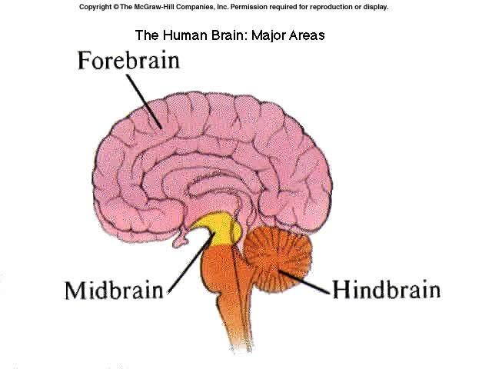
Nervous system & the brain
3 major parts of the brain
Hindbrain
Cerebellum, pons, medulla
Regulates basic functions
Sleeping, breathing, heart rate, body movements
Midbrain
Connects hindbrain & upper brain regions
Reticular activating system
Arousal states
Waking, sleeping
W/ hindbrain, they are called brain stem
Forebrain
Two cerebral hemispheres
Outer surface is called cortex
Connected through corpus callosum
Sensory processing, motor control, higher mental functioning: learning, memory

Slide 6
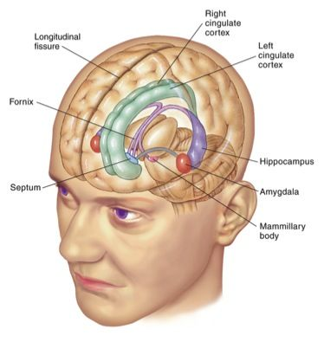
Nervous system & the brain
Subcortical structures
Limbic system
Hippocampus, amygdala, hemispheres, thalamus, hypothalamus
Memory, regulation of emotion, biological urges
Thalamus
Relaying information btw the cerebral hemispheres & other parts of the CNS
Hypothalamus
Regulates basic urges
Hunger, thirst, sexual activity

Slide 7
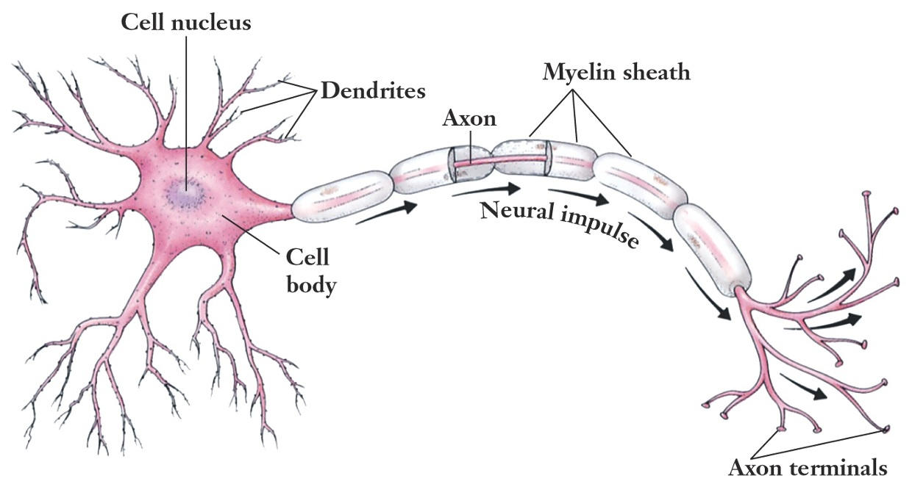
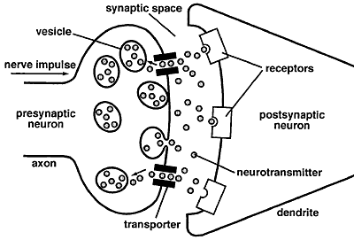
Nervous system & the brain
Neurotransmission
3 major parts of the neurons
Dendrites
Receive chemical messages from other neurons
Cell body
Axon
Neurochemicals released
Communication w/ neurons occur across the synapse
Plasticity
Flexibility of the brain to recover
Vision, audition, motor, language functioning

Slide 8
NS & Risk for Disordered Behavior
Abnormal behavior can result from
anomalies of the genetic process that guide NS development
Events occured during pregnancy
Prenatal
Perinatal
Postnatal

Slide 9
NS & Risk for Disordered Behavior
Prenatal influences
Poor maternal diet
Poor maternal health
Maternal stress
Teratogens
Harmful substances w/in mpther’s bloodstream
Drugs, alcohol, tobacco
Environmental contaminants
Radiation, ennvironmental pollution
Maternal diseases
Rubella, syphilis, AIDS
Malformation
Low birth weight
Fetal death
Functional & behavioral impairment
Miscarriage

Slide 10
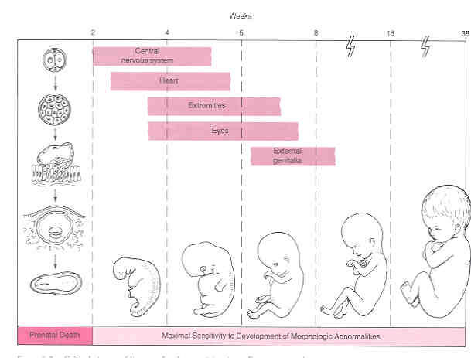
NS & Risk for Disordered Behavior
Prenatal influences (cont’d)
Teratogens may interfere w/ brain cell formation & migration
Timing of the exposure

Slide 11
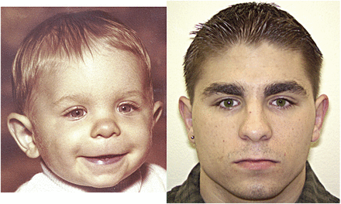
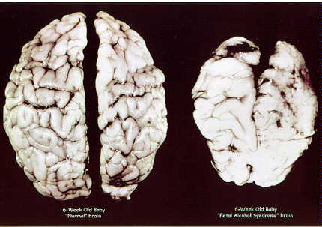
NS & Risk for Disordered Behavior
Prenatal influences (cont’d)
Fetal Alcohol Syndrome
Abnormal brain development
Retarded growth
Brith defects
Neurological symptoms
Impaired motor skills
Facial abnormalities
Reduced brain volume
Malformations of corpus callosum
Pschological problems
Lower intelligence
Specific cognitive impairments
Learning disabilities
Hyperactivity
Conduct disorder

Slide 12
NS & Risk for Disordered Behavior
Perinatal influences
Excessive medication given to mother
Unusual delivery
Pre or Postterm delivery
Premature babies
Before 37 weeks
Postmature babies
After 37 weeks
Fetal distress
Perinatal asphyxia
Deprivation of oxygen
Birth complications
Anoxia
Lack of oxygen
Low birth weight

Slide 13
NS & Risk for Disordered Behavior
Postnatal influences
Malnutrition
Accident
Illness
Exposure to chemicals
Air pollution
Second hand smoking

Slide 14
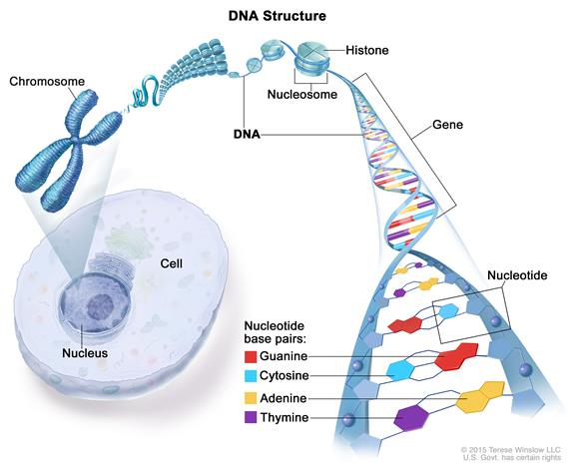
Genetics
Chromosomes contain DNAs
Chromosomes may exchange genes, break, reattach to each other, or change by mutation.
DNA has functional segments of genes.
Genetic code refers the orderin which 4 nucleotits appear in particiular regions of the gene.
Genetic code is the basis for transcription of messenger RNA.
Messenger RNA carries the information ot other parts of the cell
Translation of the code into the manifacture of proteins
23 pairs of chromosomes in humans
The study of genetic influences (genotype) on individual differeneces in behavior is known as behavior genetics.
Behavioral phenotypes of genes

Slide 15
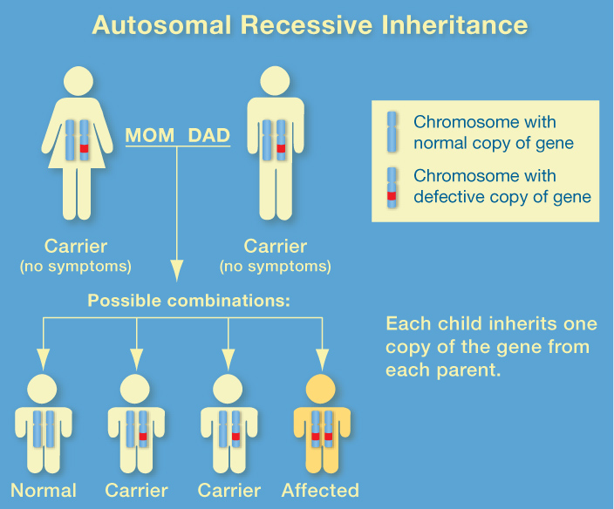
Genetics
Single-gene inheritence
2 parents & 1 offspring
Dominant gene
Gene transmitted display of associating traits
Recessive gene
Its transmission is only when 2 parents have this gene
Dominant & recessive patterns of inheritence & sex-linked pattern are involved in the heritence of many human attributes and disorders.
Effects of single genes are quite predictable
All-or-none prescence of phenotype

Slide 16
Genetics
Multiple-gene inheritence
Multiple genes are more often implicated in complex human characteristics
Intelligence, psychological disorders, etc.
Quantitative genetic methods
Allows the assessment of genetic heritability
The degree of which genetic influence accounts for variance in behavior among individual in the population studied.
Family, twin, and adoption studies
Quantitative trait loci (QTL)
Genes are inherited in usual ways
Each gene heas relatively small influence, but combination of genes create a larger effect
One gene may not be sufficient or necessary to develop a disorder

Slide 17
Genetics
Multiple-gene inheritence (cont’d)
Shared environmental influences
Influences that contribute to family members developing in similar ways
Divorce, environmental pollution, etc.
Non-shared environmental influences
Influences that are different for children growing up in the same family and result in siblings being different from each other.
Having different teacher

Slide 18
Genetics
Molecular genetics
Search for genes related to a disorder
Linkage analysis
Reveal the location of the gene
Determine whether a specific disorder appears in family members
Association analysis
Whether a spcific gene is related to a trait or disorder in the population
Comparison of people w/ a specific form of gene w/ control group
Genome-wide linkage analysis
Genome-wide association analysis

Slide 19
Genetics
Intterplay between genes & environment
Gene-environment interaction (GXE)
Differential sensivity to experience due to difference in genotype
Gene-environment correlation (GE)
Genetic differences in exposure to environments
Shows that person’s experiences are not independent of genetic influences
3 types
Passive
Parents transmit both their genes & gene-related rearing environments to the offspring
Reactive
Child’s genetic endowment & reaction from others to the child’s gene-related characteristics
Active
Child’s genetic endowment & the child’s selective active selection of gene-related experiences

Slide 20
Learning & condition
Abilities of learn & think become advanced over time
These abilities facilitate other types of developmental as interact w/ environment
Classical conditioning
Little Albert
Peter case
Operant learning
Thorndike’s law of effect
Skinner
Knowledge is learned, adaptive & maladaptive behaviours are shaped

Slide 21
Learning & condition
Observational learning
Learning through other’s experiences
May lead to both the acquisition & the removal of the problem
Can be generalized
4 processes governing Observational Learning
Attention
Representation
Behavioral production
Motivation

Slide 22
Processes Governing Observational Learning
4 processes that govern observational learning
Attention
Before we can model another person, we must attend to that person.
individuals with whom we frequently associate
attractive models
the nature of the behavior being modeled
Representation
In order for observation to lead to new response patterns, those patterns must be symbolically represented in memory
observations are retained in imagery and can be summoned in the absence of the physical model
Verbal coding greatly speeds the process of observational learning
Verbal coding helps to rehearse the behavior symbolically

Slide 23
Processes Governing Observational Learning
Four processes that govern observational learning (cont’d)
Behavioral Production
After attending to a model and retaining what we have observed, we then produce the behavior.
Monitor behavior
Performance evaluation
Motivation
Observational learning is most effective when learners are motivated to perform the modeled behavior
Others may teach us how to do something, we may have no desire to perform the necessary action

Slide 24
Learning & condition
Cognitive-Behavioral Perspective
Covers cognition, emotion, behavior, & social factors
Maladaptive cognitions are related to maladaptive behavior
Schemata
Condition
Seeing a cat
Cognition
Cat hurts me
Emotion
Worry
Behavior
Avoidance of cat
Anxiety

Slide 25
Learning & condition
Early maladaptive schemata & schema coping styles
Early maladaptive schemata
A broad, pervasive theme or pattern; comprised of memories, emotions, cognitions, and bodily sensations; regarding oneself and one’s relationships with others; developed during childhood or adolescence; elaborated throughout one’s lifetime; and dysfunctional to a significant degree.
Self-defeating emotional and cognitive patterns that starts to early in our development and repeat throughout our lives.
(Young, Klosko, & Weishaar, 2003)

Slide 26
Learning & condition
Five domains of early maladaptive schemata
Disconnection & rejection
abandonment/instability; mistrust/abuse; emotional deprivation with deprivation of nurturance, empathy, and protection; defectiveness/shame; and social isolation/alienation.
Impaired autonomy & performance
dependence/incompetence; vulnerability to harm or illness; enmeshment/undeveloped self, and failure.
Impaired limits
entitlement/grandiosity, insufficient self-control/self-discipline.
Other-directedness
subjugation with needs and emotions, self-Sacrifice, and approval-seeking/recognition-seeking
Overvigilance & inhibition
negativity/pessimism; emotional inhibition; unrelenting standards / hypercriticalness, and & punitiveness.

Slide 27
Learning & condition
Schema coping styles
2 fundamental schema operations
Schema perpetuation & Schema healing
Schema perpetuation
everything the patient does internally and behaviorally aims to keeps the schema continuing.
through 3 primary mechanisms
Cognitive distortions: misperception of situations, accentuating information that confirms the schema, & minimizing or denying information that contradicts the schema
Self-defeating life patterns
Schema coping styles
strategies help people to deal with his/her schema
In the form of behavior, emotion, & cognition
overcompensation, avoidance, & surrender
(Young, Klosko, & Weishaar, 2003)

Slide 28
Learning & condition
Cognitive distortions
Inaccurate thought processes that are dysfunctional
Cognitive deficits
Abscence of thinking

Slide 29
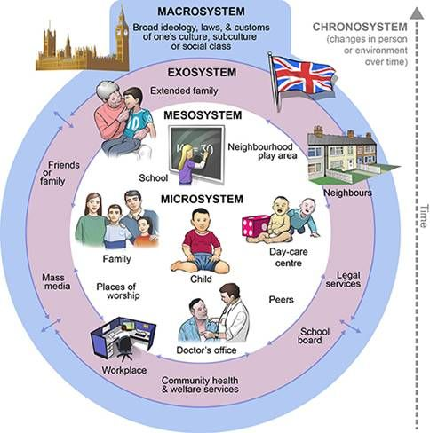
Sociocultural context
The potential interactions among the system
Ecology
Interrelationship of organisms & their environment
3 contexts
Family
Community
Society/culture
Each contexts consist of structures, institutions, values, rules & r/ships
Proximal contexts have more direct impact on child

Slide 30
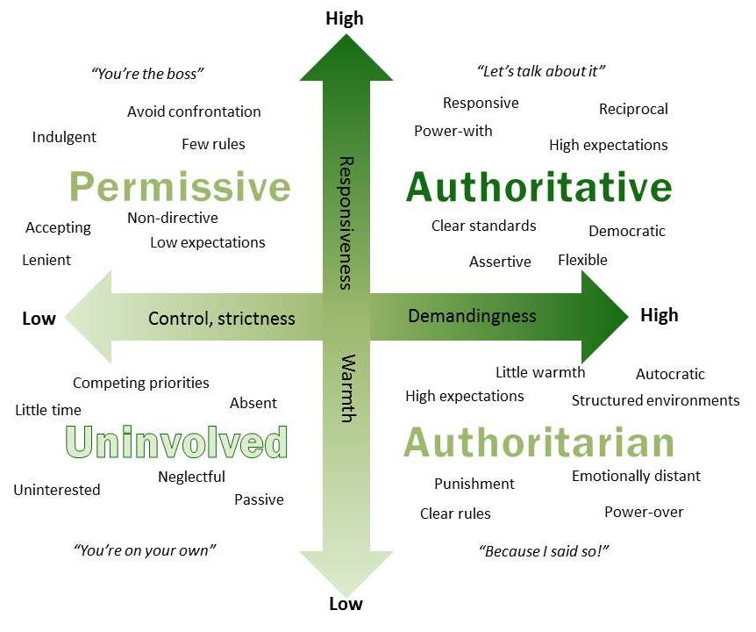
Sociocultural context
Role of family
Parenting
Role of mothers & fathers
Gender roles & cultural values
Emotional involvement & guidance
Parenting styles
Effective Parenting
Consider youth’s needs & developmental level
Interaction w/in family system
Culture
Parental psychopathology
Genetic transmission
Parenting

Slide 31
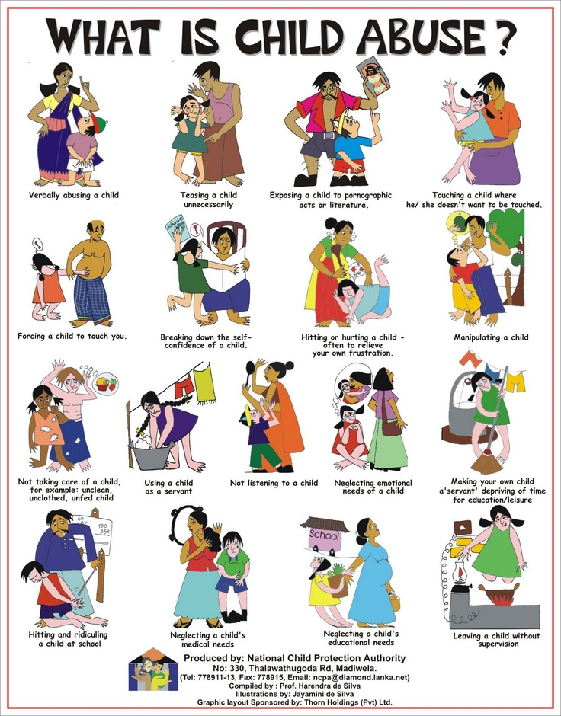
Sociocultural context
Maltreatment
Extreme failure to provide adequate parenting
Battered child syndrome
Nonaccidental injuries seen in the pediatry clinics
Means both abuse & neglect
Physical abuse
Sexual abuse
Verbal abuse
Emotional abuse
Economical abuse
Physical neglect
Emotional neglect

Slide 32
Sociocultural context
Maltreatment
Munchausen by proxy syndrome
a relatively rare form of child abuse
involves the exaggeration or fabrication of illnesses or symptoms by a primary caretaker.
a need for attention and sympathy from doctors, nurses, and other professionals

Slide 33
Sociocultural context
Factors contributing to maltreatment
Characteristics of the abuser
Characteristics of the child
Parenting practices
Parent-child interactional processes
Social / cultural influences
Consequences of maltreatment
Basic developmental processes are disrupted by maltreatment
Fewer opportunities for positive experiences
Dysregulation of stress regulation
Alteration of neurotransmitters
Alterations of structural & functional regions of brain
Cognitive & psychosocial difficulties
Resiliency

Slide 34
Sociocultural context
Divorce
The divorce rate is increased i 1960s-70s.
Rate is declining recently
About 50% of marriages & 60% of 2nd marriages end in divorce
Family transitions & adjustments
Academic, social, emotional, & behavioral dysfunction
The degree of marital discord prior to the divorce is influential on adjustment of children in the family
Preexisting individual characteristics
Children’s temperament
Boys are more affected by divorce, girls by remarriage
Culture

Slide 35
Sociocultural context
Peer influence
Essential role on development of sociability, empathy, cooperation, morality,
Conflict management, competition, anger management, socialization of sexuality & gender roles
Prevents or reduces the likelihood of disorder
Parental hostility, coercion, lack of involvement, & authoritarian/restrictive styles are associated w/ child agression & peer rejection
Teachers’ roles
Similarity w/ peers make adaptation easier
May courage deviant behavior

Slide 36
Sociocultural context
School
May be a protective or risk factor
Teacher-parent interaction
Teacher-student interaction
Changing school demands
Socializing
Peer influences
Succesful completion of school contributes to normal developement
Drop out of school
Inattendance
Prevention programs for failure, substance abuse, enhancing social competence, and prosocial behavior
Courses about animals & how to become a ‘hero’

Slide 37
Sociocultural context
SES & poverty
Income, educational achievement, and occupational level
Correlated w/ one another
In low SES, increasing risk of
Developmental delay
Learning disabilities
School failure
Behavioral & psychological problems
Poverty’s persistence, timing & depth are essential
Family process mediates the influence of poverty
The stress of being poor may increase the likelihood of parent-child conflict
Stimulating environment effects the brain volume & gray matter of the hippocampus

Slide 38
Sociocultural context
Neighborhoods
Influences academic skills, mental health, & sexuality
Affluent neigboorhood is essential especailly for school readiness & achievement
Low SES & acting-out/aggressive behavior are positively correlated
According to Levental & Brooks-Gun (2000),
Community resources
Relationships
Community norms / collective efficacy moderates btw neighborhood features & youth outcomes
Volunteers families

Slide 39
Sociocultural context
Culture, Ethnicity, & minority status
Both positive & negative effect
Acculturation
Indigenious groups have higher rates of poverty, psychopathology, health problems, educational disadvantages, & so on.
High rates of birth, unemployment, suicide, homicide, alcholosim, & death relatives
Immigrants & minority groups
Prejudice & discrimination
Related to lower academic achievement
Aggression
Antisocial acts
Depression

Slide 40
The end...

