Slide 1
Developmental Psychopathology
The Developmental Psychopathology Perspective
Assist. Prof. Merve Topcu
Çankaya Unıversity
Spring, 2017

Slide 2
Models and theories
Set of principles used to analyze or explain a set of phenomena
Example: temper tantrums

Slide 3
Why use models/theories?
Intuitive scientists
Effective and efficient
Testable hypotheses

Slide 4
Problems with models
May prevent us from seeing important aspects of a problem
Will direct the way choose to treat the problem

Slide 5
How to judge a theory
Comprehensiveness
Parsimony
Empirical validity
Testability
Usefulness

Slide 6
Developmental Considerations (cont.)
Developmental Psychopathology Perspective
Multidisiplinary field
Clinical Ψ & Developmental Ψ
stresses the importance of developmental processes
viewed as a macroparadigm
to understand maladaptive behavior, must know normative behavior
Interested in origin, developmental course, and outcome of the disordered behavior

Slide 7
Developmental Psychopathology Perspective (cont.)
Figure 2.3 Developmental psychopathology as a macroparadigm. Based on Achenback, 1990).

Slide 8
Biological Model
Interested in underlying organic pathology; considers brain and nervous system functions as underlying causes of psychological disorders
Genes: produce a tendency
Temperament: activity, emotionality, sociability, aggressive/impulsive
Toxins/drugs
Physical illness/trauma
Neurotransmitters

Slide 10
Biological Models (cont.)
Neurobiological Contributions:
different areas of the brain regulate different functions and behaviors
the endocrine system--hormones;
especially implicated in health- and stress-related disorders

Slide 11
Biological Models (cont.)
Neural Plasticity and the Role of Experience
maturation of the brain is an organized, hierarchical process
consequences of traumatic experience
E.g., Shaken baby syndrome

Slide 12
Benefits and drawbacks of medical model
Strengths:
Application for prevention and treatment
Reduces stigma
Takes blame off of parents
Drawbacks:
Only addresses symptoms
Fails to address environmental factors
Side effects of drugs

Slide 13
Psychodynamic Models
Dominated thinking for a long time
Not all that appropriate for kids
Not motivated/self-referred
Introspection limited
Requires stable personality structure
Doesn’t address environmental forces

Slide 14
Psychological Perspectives
Emotional Influences:
emotions tell us what to pay attention to and provide motivation for action
children may have difficulties in emotion reactivity or emotion regulation
temperament shapes the child’s approach to the environment and vice versa

Slide 15
Psychological Perspectives (cont.)
Behavioral and Learning Influences:
Applied Behavior Analysis --antecedents and consequences
classical conditioning
social learning
social cognition - how children think about themselves and others

Slide 16
Importance of Learning Perspectives
Optimistic about change
Simple, straightforward
Downplays previous life history
Leads to treatment interventions
Forces us to be concrete
Strong record keeping
Active involvement for parents and teachers
Scientific base
efficient

Slide 17
Learning perspective problems
Tries to explain too much
Doesn’t address developmental issues well
Might ignore cognitions

Slide 18
Cognitive-Behavioral Approaches
Includes thoughts/internal experiences
Attributions
Appraisals
Expectancies
Examples:
Problem solving training
Impulse control training
Perspective taking
Limitations

Slide 19
Family, Social, and Cultural Influences
Ecological models
describe the child’s environment as a series of nested and interconnected structures

Slide 20
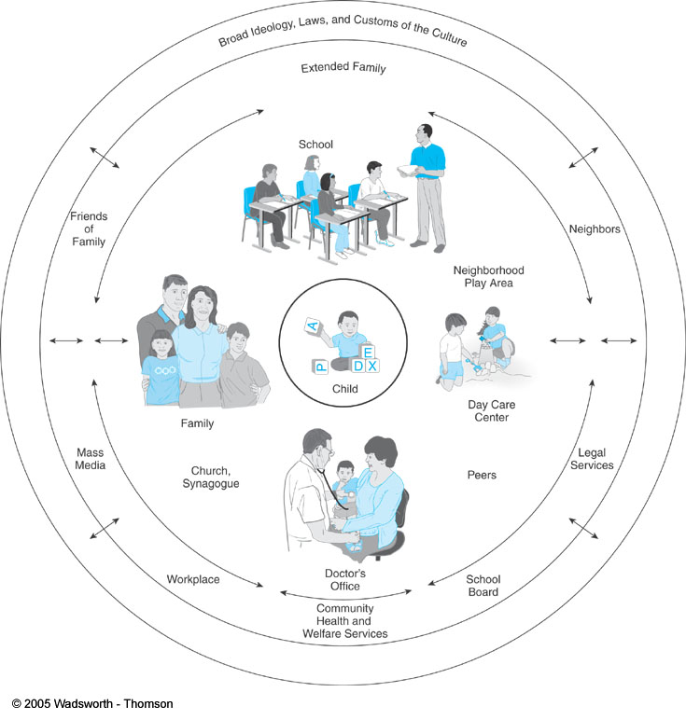
Family, Social, and Cultural Influences (cont.)
Figure 2.8 An ecological model of environmental influences.

Slide 21
Family and Social Influences (cont.)
Evolution and Attachment
attachment theory -- evolving child-caregiver relationship,
helps the child to regulate behavior and emotions, especially in conditions of threat or stress
4 patterns of attachment, types of internal working models
Secure
anxious-avoidant
anxious-resistant
disorganized

Slide 22
Family and Social Influences (cont.)
The Family and Peer Context
study of individual factors and the study of the child’s context are mutually compatible and beneficial to both theory and intervention
family system theorists study children’s behavior in relation to other family members

Slide 23
Concept of development
Growth
Getting bigger & better
Requires time
Includes change over the life span
Change may manifested in different ways
Global structures & functions (biological, motor, physical, cognitive, emotional, social systems) become more finely differentiated and then integrated.
Development process is a coherent pattern
Pathways
Depends on previous & further functioning
Narrowing possibilities with age
Change is not evitably possible
E.g., Physical change in chilhood vs old age

Slide 24
Multicausality
The development is influenced by a continuous interplay btw an active, changing person engaging in a complex, changing context
Understanding outcome rests on a multifactorial explanation
What causes the outcome
Direct & indirect causes
Mediation & moderation
Mediation
Mediator explains the reason why there is a relationship between IV & DV
Once the effect of mediator variable is removed, the relationship disappears
Moderation
Changes the strength of an effect or relationship between two variables
A moderator may increase the strength of a relationship, decrease the strength of a relationship, or change the direction of a relationship
How causal factors work together
What underlying mechanism relies beneath
Necessary & sufficient factors
E.g., Autism vs Schizophrenia

Slide 25
Example for mediation 1
When you provoke someone, they aggress against you. But why does aggression occur? Does everyone aggress?
Some research has shown that anger is the mediator variable.
In other words, the provocation causes anger, and its the anger that causes aggression. Thus, provocation (IV) causes anger (M) which causes aggression (DV).
IV: Provocations
DV: Aggression
Mediator variable: Anger

Slide 26
Example for mediation 2
IV: Social class
DV: Frequency of check up
Mediator variable: Age, money
Money
Social Class
# of checkups

Slide 27
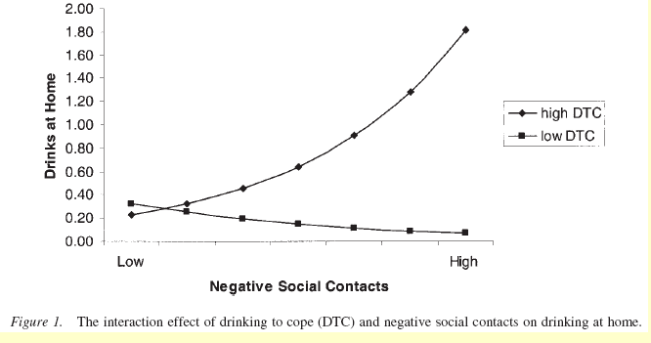
Example for moderation
IV: Disagreement w/ friend
DV: Drinks at home
Moderator variable: Avoidant coping style

Slide 28
Qs?
1. Receiving a harassing email from a coworker leads to feelings of anger which reduce overall job satisfaction.
Does this describe mediation of moderation?
2. Access to free treats during break creates positive emotional responses for workers except for those who have high negative affect (i.e., who are perpetually grumpy).
Does this describe mediation or moderation?

Slide 29
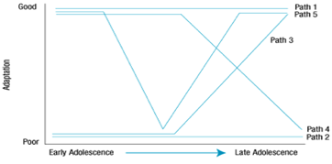
Pathways of development
Abnormal behaviour does not appear out of blue
5 different developmental pathways from early to late adolescence, with respect to children's adaptive or maladaptive behavior.
Stable adaptation
Stable maladaptation
Reversal of adaptation
Decline of adaptation
Temporal maladaptation

Slide 30
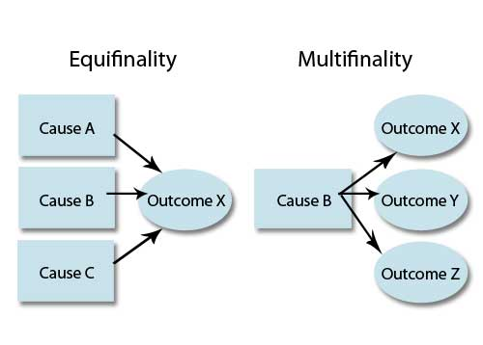
Equifinality & Multifinality
Equifinality
A given outcome can be reached from any number of different developmental paths.
Multifinality
Similar initial conditions may lead to dissimilar outcomes

Slide 31
Risk & Resilience
Risk factors
Increases the chance of psychological impairments
Moderators
Child characteristics
Environmental characeristics
Stressors
Major life events
Minor events
Chronic conditions
Mediators
Biological, Psychological, & Social processes
Psychopathology
Symptoms
Syndromes
Disorders

Slide 32
Risk & Resilience
Ecological
Crime , injustice, discrimination
Nonnormative stressful life events
Early death of a parent
Outbreak of war
Constitutional risk factors
Heredity
Gene abnormalities
Prenatal, birth complications
Postnatal
Inadequate health care, nutrition
Family
Emotional & interpersonal
Low self-esteem
Difficult temperament
Peer rejection
Intellectual & academic
Below average intelligence
Learning disability

Slide 33
Risk & Resilience
Multiple factors
Timing of the potential risk
Predictability of the risk factors
Multifinality
Risk factors for onset may be different from persistence of the disorder
Risks accumulate over time, & make more vulnerable for future

Slide 34
Risk & Resilience
Positive outcome in the face of adversity
Those who maintain healthy functioning
Absence of psychopathology or low level of symptomatology
Competence regarding developmental tasks
Adaptability
Trio of protective factors
Personal attributes of the youth
Family characteristics
Support from outside family
Rutter’s description of four protective mechanisms
Reduction of risk impact
Reduction of negative chain reactions
Establishment and maintenance of self-esteem and self-efficacy
Opening up of opportunities

Slide 35
Continuity & change
Does a behavior disorder at an earlier time in life carry over, or predict, the disorder later life?
Discomfort & growth
Stable symptom presentation over time?
Heterotypic continuity
Processes are responsible for change
R/ship btw temper tantrums & ill-tempered motherhood
Cumulative continuity
Interactional continuity

Slide 36
Early attachment
Emotional –social bond btw child & caregiver is called attachment
Seen in 7-9 months
Organized pattern of behaviors that protect child against high levels of fear in stressful situations
Ainsworth, the Strange situation
In predetermined schedules, mothers leave the babies in the room
Babies are observed
Types of attachment styles
Secure
Not distressed at separation
Easily soothed
Positive reaction to mother’s return
Insecure attachment
Avoidant type
Avoid contact when mother returns
Not easily soothed

Slide 37
Early attachment
Disorganized / disoriented attachment
Lack of consistent strategy to organize behavior under stress
Children’s of parents who are depressed or use alcohol or drugs
Seeing parent threatening
Academic problems
Later emotional & behavior problems
Low self-esteem
Poor peer interaction
Bizarre classroom behavior
Need research on biological bases
Attachment patterns are not stable over time
Internal working models may change

Slide 38
Temperament
Basic disposition
Thomas and Chess’s Temperament Types
Heredity, neural, and hormonal factors affect response to the environment.
can be modulated by environmental factors; parental response.
“Goodness of fit”:
the degree to which an individual’s temperament is compatible with the demands and expectations of his or her social environment
Parents can modulate children’s temperament by their influences on the environment.

Slide 39
Temperament
Thomas and Chess’s Temperament Types
Easy babies: 40% of infants
adjust easily to new situations, quickly establish routines, are generally cheerful and easy to calm.
Difficult babies: 10% of infants
slow to adjust to new experiences, likely to react negatively and intensely to stimuli and events.
Slow-to-warm-up babies: 15% of infants
somewhat difficult at first but become easier over time.

Slide 40
Temperament
9 dimensions
1. Activity Level:
How active the child is generally
Highly active children may channel such extra energy into success in sports
2. Distractibility:
The degree of concentration and paying attention displayed when a child is not particularly interested in an activity
3. Intensity:
The energy level of a response whether positive or negative
Does the infant react strongly and loudly to everything, even relatively minor events?
Good at drama
4. Regularity:
The trait refers to the predictability of biological functions like appetite and sleep.
As grown-ups irregular individuals may do better than others with traveling as well as be likely to adapt to careers with unusual working hours.

Slide 41
Temperament
9 dimensions (cont’d)
Sensory Threshold:
Related to how sensitive this child is to physical stimuli
Highly sensitive individuals are more likely to be artistic and creative.
Approach/Withdrawal:
Refers to the child’s characteristic response to a new situation or strangers.
Slow-to-warm up children tend to think before they act.
They are less likely to act impulsively during adolescence.
Adaptability:
Related to how easily the child adapts to transitions and changes, like switching to a new activity.
A slow-to-adapt child is less likely to rush into dangerous situations, and may be less influenced by peer pressure.
Persistence:
This is the length of time a child continues in activities in the face of obstacles.
The highly persistent child is more likely to succeed in reaching goals.
A child with low persistence may develop strong social skills because he realizes other people can help.
Mood:
This is the tendency to react to the world primarily in a positive or negative way.
Does the child see the glass as half full?
Serious children tend to be analytical and evaluate situations carefully.

Slide 42
Temperament
Behaviorally inhibited temperament
When exposed to unfamiliar stimuli in infancy, they are biologically reactive
They are known as shy & socially w/drawn
Associated w/ later anxiety & depression

Slide 43
Emotional regulation
Feelings
Overt expressions
Autonomic nervous system arousal
By the age of 2-5, connections between emotions & cognitions are established
Also shaped by social context
Development of sympathy and conscious for others

Slide 44
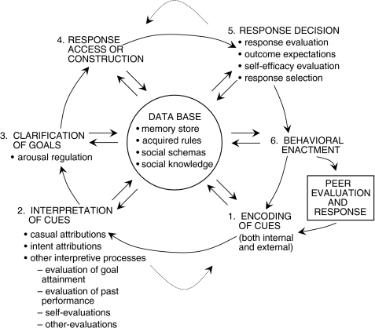
Social - Cognitive Processing
Thinking about the social word
Crick & Dodge’s (1994) Social – Cognitive Processing Model

Slide 45
Social - Cognitive Processing
Interpretation of the cues can play in maladaptive behavior
Attention starts the processing
Emotion is viewed as playing central role in the theory

